Slide 1

IBM SkillsBuild for Adult Learners - Data Analytics
Data Analytics Internship Program 2024 Final Project Presentation
Project Name: Analyzing the Contribution of Human Activities to Frequent Flooding in India
Unique ID: IBM2487 Team Name: The Data Detectives
College Name: MAHARAJA AGRASEN INSTITUTE OF TECHNOLOGY, DELHI

Slide 2




Team Members
S NO. | NAME | TEAM NAME | NUMBER | COLLEGE
1 | Aman kothari | The Data Detectives | 8700668586 | Maharaja Agarsen Institute of Technology
2 | Manasvi Sinha (T. Ld) | The Data Detectives | 9811846552 | Maharaja Agarsen Institute of Technology
3 | Suryanshu Verma | The Data Detectives | 9868808014 | Maharaja Agarsen Institute of Technology
4 | Vishal Pandey | The Data Detectives | 7982740638 | Maharaja Agarsen Institute of Technology

Slide 3
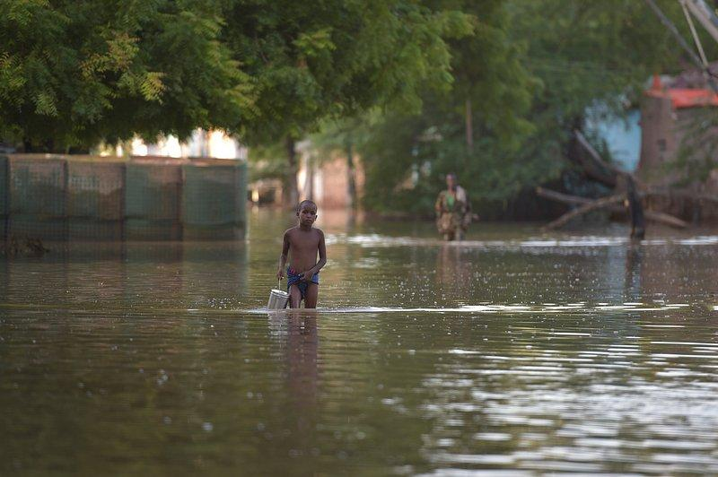
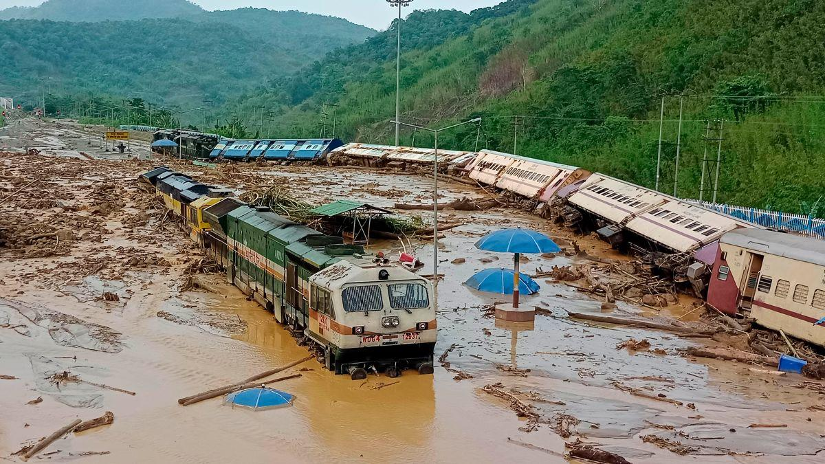
Project Overview
This project aims to analyze the impact of deforestation and floodplain encroachment on the frequency of floods in India. By collecting and preprocessing data from reliable sources, performing statistical and spatial analysis, and developing predictive models, the project seeks to identify key factors contributing to increased flood risks. The outcomes include actionable solutions for mitigating flood risks through better land-use regulations and conservation strategies
Objective
To analyze the impact of deforestation and floodplain encroachment on the frequency of floods in India and propose evidence-based policy recommendations and solutions to mitigate these risks and enhance urban resilience.
Introduction

Slide 4
Problem Identification
Problem Statement
Deforestation and floodplain encroachment in India significantly increase flood frequency and severity. This project analyzes these factors to inform effective flood management and mitigation strategies.
Significance of the Problem
Frequent flooding in India endangers lives, property, and the economy. Addressing deforestation and floodplain encroachment is crucial for reducing flood risks and promoting sustainable development.
Relevant SDGs
This project aligns with SDG 11 (Sustainable Cities and Communities), SDG 13 (Climate Action), and SDG 15 (Life on Land), promoting sustainable land use and enhancing urban resilience against flooding.

Slide 5
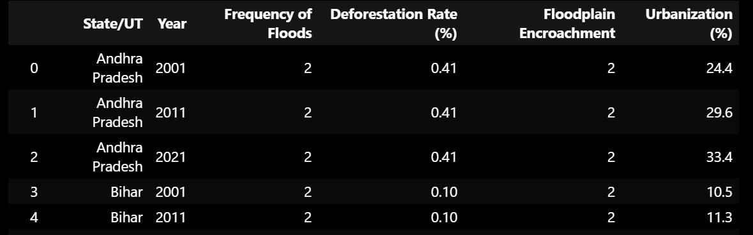
Data Collection
Sources of Data
Data will be sourced from reputable platforms including Data.gov.in, Kaggle, IMD (India Meteorological Department), CWC (Central Water Commission), NDMA (National Disaster Management Authority), and satellite data platforms. These sources provide comprehensive and reliable data essential for accurate analysis.
Data Description
The dataset encompasses deforestation rates, floodplain encroachment, flood incidents, and rainfall patterns over several years. It includes spatial and temporal data that highlight changes in land use and environmental conditions. This comprehensive data will help in identifying trends and correlations crucial for the analysis.
Data Collection Methods
Data will be collected through official government databases, satellite imagery, and environmental reports. Satellite data will provide accurate spatial information on deforestation and floodplain encroachment, while historical records from IMD, CWC, and NDMA will offer insights into flood incidents and rainfall patterns. Data cleaning and preprocessing will ensure accuracy and consistency for analysis.

Slide 6
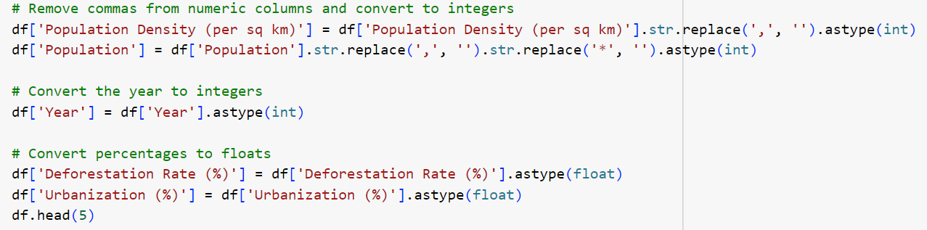
Data Preprocessing
Data Cleaning Methods
Data cleaning involved removing any commas and asterisks from numerical columns, standardizing units, and converting data types appropriately. Categorical variables were encoded using mapping techniques for consistency.
Handling Missing Values
Missing values were handled using forward-fill (ffill) method, which propagates the last valid observation forward. This ensured a continuous dataset without gaps, maintaining data integrity for analysis.
Data Transformation Techniques
Data transformation included encoding categorical variables to numerical values, converting percentages to float, and ensuring the 'Year' column was in integer format. These transformations allowed for efficient analysis and modeling.

Slide 7
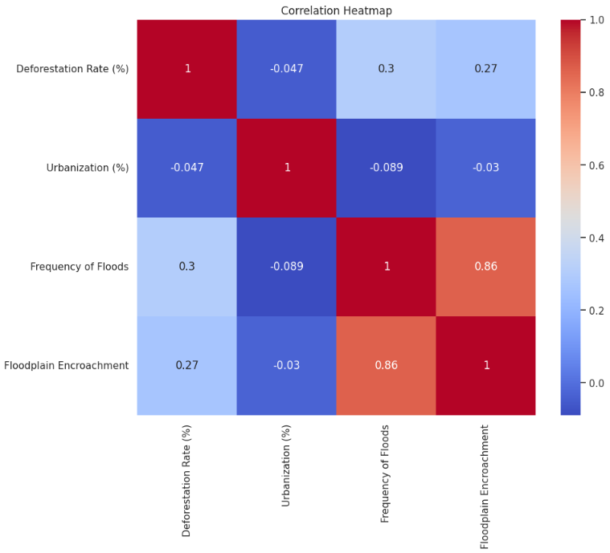
Analytical Tools and Methods Used
The analysis employed Python libraries including pandas for data processing, seaborn and matplotlib for visualization, and scikit-learn for predictive modeling. Correlation analysis and heatmaps were used to explore relationships between variables.
Key Findings
The analysis revealed a strong correlation between floodplain encroachment and the frequency of floods (0.86), indicating it as the primary human-induced factor. Deforestation also showed a moderate correlation (0.30), whereas urbanization away from water bodies had a negligible impact (-0.09).
Insights Derived
The study identified floodplain encroachment as the most significant contributor to flooding, followed by deforestation. Urbanization away from rivers or water bodies did not significantly affect flood frequency. These findings underscore the need for policies focused on preventing floodplain encroachment and promoting reforestation to mitigate flood risks.
Data Analysis

Slide 8
Hypothesis Development
Formulated Hypothesis
The hypothesis posited that floodplain encroachment and deforestation significantly contribute to the frequency of floods, while urbanization away from water bodies has a minimal impact.
Rationale Behind the Hypothesis
This hypothesis was based on the assumption that human activities such as encroaching on floodplains and deforestation disrupt natural water flow and increase flood risk. Conversely, urbanization away from water bodies was expected to have a lesser effect on flood frequency.
Method for Testing the Hypothesis
The hypothesis was tested using correlation analysis to measure the relationship between flood frequency and the variables of interest. Predictive models were developed and validated to quantify the impact of floodplain encroachment, deforestation, and urbanization on flood occurrences.

Slide 9
Solution Design
Proposed Solution
To address floodplain encroachment and deforestation, the proposed solution involves implementing strict land-use regulations and promoting reforestation programs. Countries should enforce policies to prevent construction in flood-prone areas and restore natural floodplains and forests.
Implementation Plan
1. Regulatory Measures: Enforce and monitor land-use regulations that prohibit construction in floodplains.
2. Reforestation Initiatives: Launch large-scale reforestation projects to restore deforested areas and improve watershed management.
3. Public Awareness: Educate communities about the benefits of preserving floodplains and forests and involve local stakeholders in conservation efforts.
4. Monitoring and Evaluation: Establish systems to monitor deforestation and floodplain encroachment, and evaluate the effectiveness of implemented measures.
Alignment with SDGs
The proposed solution aligns with SDG 11 (Sustainable Cities and Communities) by promoting resilient infrastructure and sustainable urban planning. It also supports SDG 15 (Life on Land) by addressing deforestation and ecosystem degradation, contributing to the preservation of terrestrial ecosystems and biodiversity.

Slide 10
Visualization
Data Visualization Techniques Used
Charts and Graphs: Bar plots and scatter plots were employed to illustrate relationships between flood frequency and factors like deforestation, urbanization, and floodplain encroachment.
Heatmaps: Correlation heatmaps were used to visualize the strength and direction of correlations among different variables.
ROC Curves and Confusion Matrix: These were utilized to evaluate the performance of predictive models, including classification accuracy and model robustness.
Key Visual Insight
Scatter Plots and Bar Charts: Revealed that floodplain encroachment has the strongest correlation with flood frequency, while deforestation also impacts flood frequency but to a lesser extent. Urbanization showed minimal impact on flood frequency.
Correlation Heatmap: Highlighted a high correlation between floodplain encroachment and flood frequency, suggesting that encroachment is a significant man-made contributor to increased flooding.

Slide 11
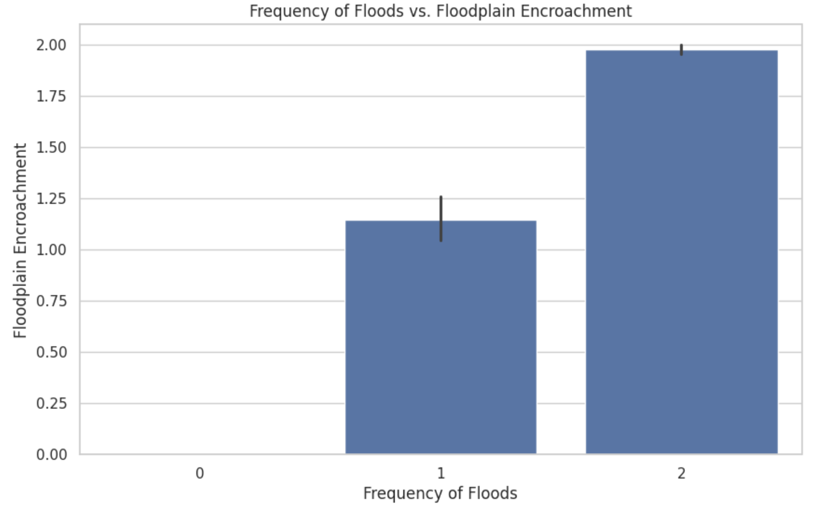
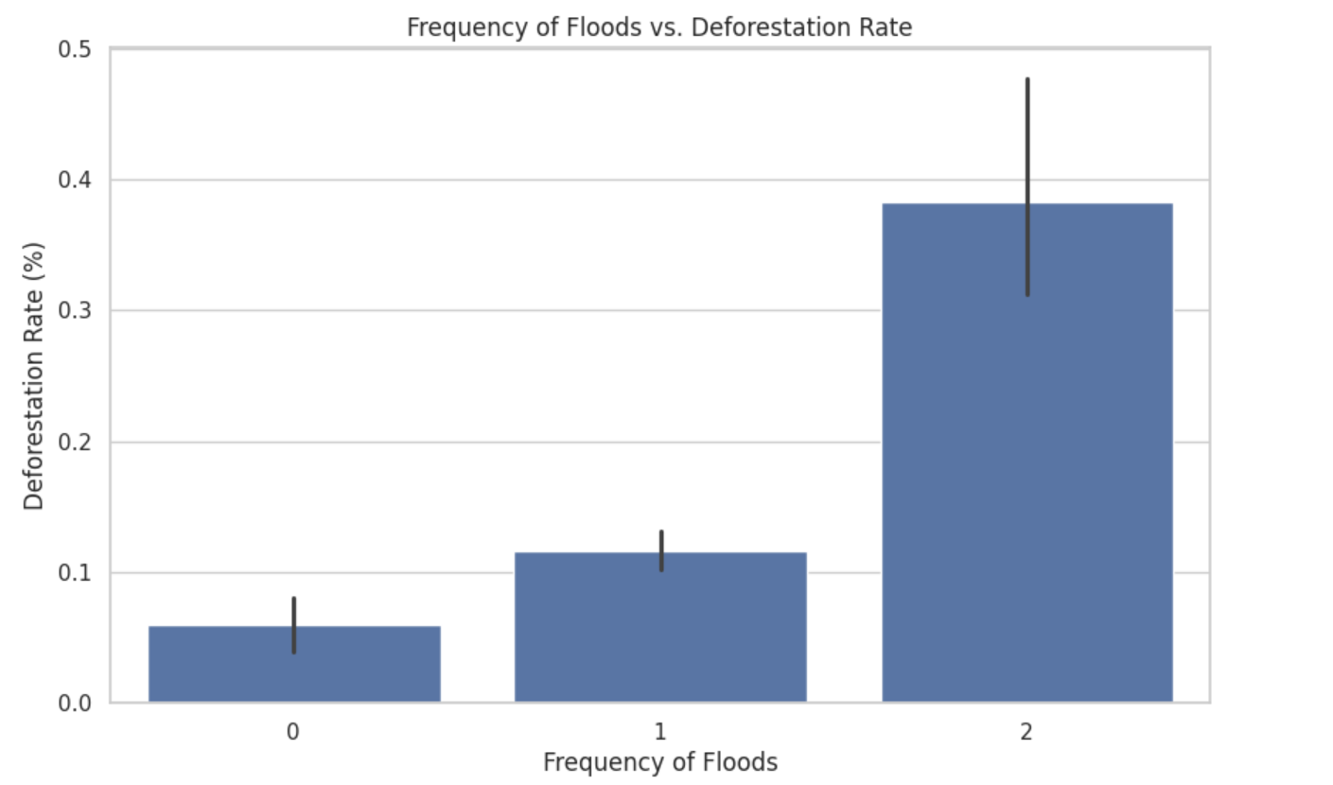

Slide 12
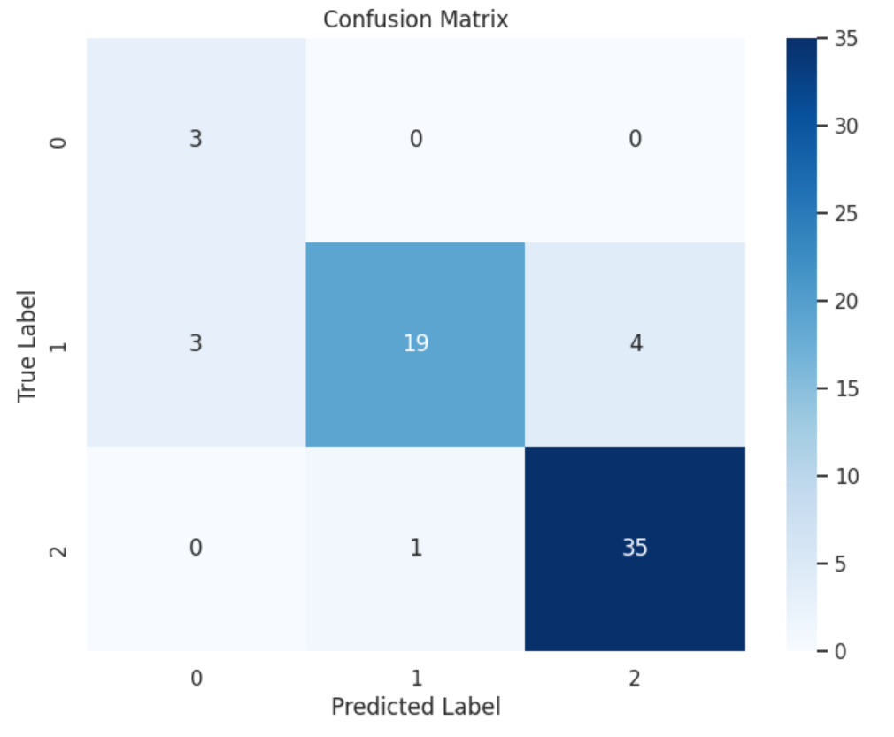
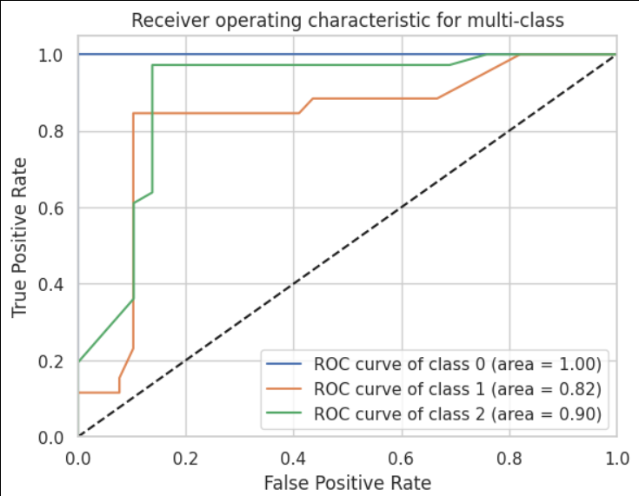

Slide 14
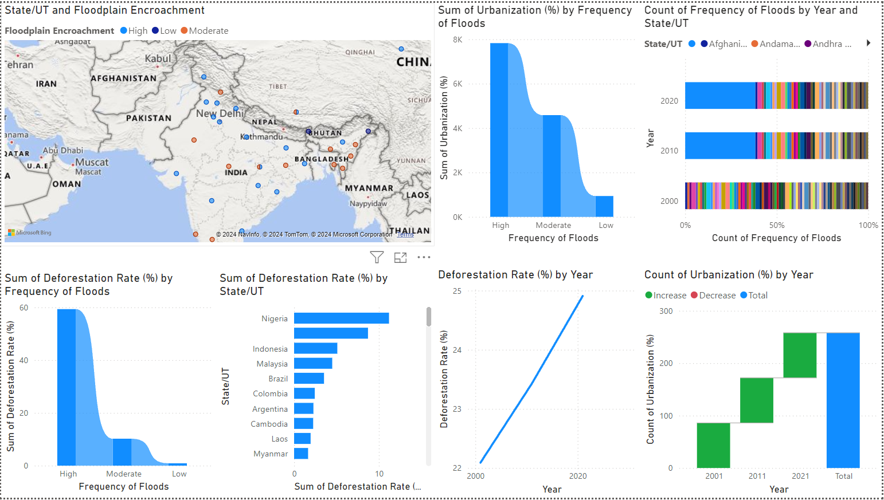

Slide 15
Conclusion
1. Summary of Findings
Strong correlation between floodplain encroachment and frequency of floods.
Positive correlation between deforestation and flood frequency, but less significant.
Negligible impact of urbanization away from water bodies on flooding.
Need to address floodplain encroachment and deforestation to mitigate flood risks.
2. Impact of Proposed Solution
Stricter land-use regulations and conservation strategies can reduce flood frequency and severity.
Protection of human lives and properties along with natural ecosystems.
Alignment with SDGs by promoting responsible urban planning and environmental conservation.
Ensures long-term resilience against flooding.
3. Future Work
Focus on detailed spatial analysis using GIS tools for targeted interventions.
Development of more sophisticated predictive models with additional environmental variables.
Collaboration with policymakers and local communities for implementation and monitoring.
Essential for sustainable flood management and risk reduction.

Slide 16
References
Data Sources
Data.gov.in: Government of India open data portal.
Kaggle: Platform for datasets and data science competitions.
IMD (India Meteorological Department): Weather and climate data.
CWC (Central Water Commission): Water resource data.
NDMA (National Disaster Management Authority): Disaster management and flood data.
Tools and Software Used
Pandas: Data manipulation and analysis library.
NumPy: Numerical computing library.
Matplotlib: Visualization library for plotting graphs and charts.
Seaborn: Data visualization library based on Matplotlib.
Scikit-learn: Machine learning library for predictive modeling.
Additional References
UN SDGs: United Nations Sustainable Development Goals framework.
Research Articles: Studies on the impact of urbanization, deforestation, and floodplain encroachment on flooding.
Government Reports: Documents from IMD, CWC, and NDMA related to flood management and environmental conservation.
Textbooks: Relevant textbooks on environmental science, urban planning, and disaster management.

